Slide 1
Lecture 5: Circuit Partitioning – III
Tsung-Wei (TW) Huang
Department of Electrical and Computer Engineering
University of Utah, Salt Lake City, UT

Slide 2
Programming Assignment #1
Implement FM partitioning algorithm
https://github.com/tsung-wei-huang/ece5960-physical-design/tree/main/PA1
Two checkpoint dues, 9/7 and 9/14 23:59 PM
https://github.com/tsung-wei-huang/ece5960-physical-design/issues/2
Final Due on 9/21 (Wed) 23:59 PM
Upload your solutions to twhuang-server-01.ece.utah.edu
Account: ece6960-fall22
Place your source code + README under PA1/your_uid/
README should contain instruction to compile & run your code

Slide 3
Programming Assignment #1 (cont’d)
In addition to source code + README, upload a report with:
A table showing your results of each benchmark
A section discussing what challenges you encounter
A section discussing how you overcome those challenges
Also discuss unsolved challenges
The report needs to be just a one- or two-page pdf
No need to be lengthy …
Upload your report to the class GitHub page
https://github.com/tsung-wei-huang/ece5960-physical-design/issues/1
Due 9/21 23:59 PM

Slide 4
In-class Presentation: 9/14
Circuit partition research presentation on 9/14 (in class)
George Karypis and Vipin Kumar, "Multilevel k-way Hypergraph Partitioning," 1999 ACM/IEEE DAC – presented by W-L Lee
Honghua Yang and Martin Wong, "Efficient Network Flow Based Min-Cut Balanced Partitioning," 1994 ACM/IEEE ICCAD – presented by Randy
Masahiro Tanaka, Kenjiro Taura, Toshihiro Hanawa, Kentaro Torisawa, "Automatic Graph Partitioning for Very Large-scale Deep Learning," 2021 IEEE IPDPS 2021 – presented by McKay
Instructions
Upload your pptx to https://github.com/tsung-wei-huang/ece5960-physical-design/issues/9
Template is available here: https://github.com/tsung-wei-huang/ece5960-physical-design/blob/main/Presentation/template.pptx

Slide 5

Mid-Autumn Festival
Notes:
So, many of you probably know for people from Asia, like Taiwan, China, Hong Kong, Korea, Singapore etc, this week is the moon festival or mid-autumn festival. This festival is about lunar appreciation and moon watching, and mooncakes are usually a sacrifice of the festival. We offer mooncakes between friends or on family gatherings while celebrating the festival. You know, this is one of the most important festivals for many Asian. So, please take one piece and enjoy it!
While you are eating, I will be happy to answer any questions you have in programming assignment #1.

Slide 6
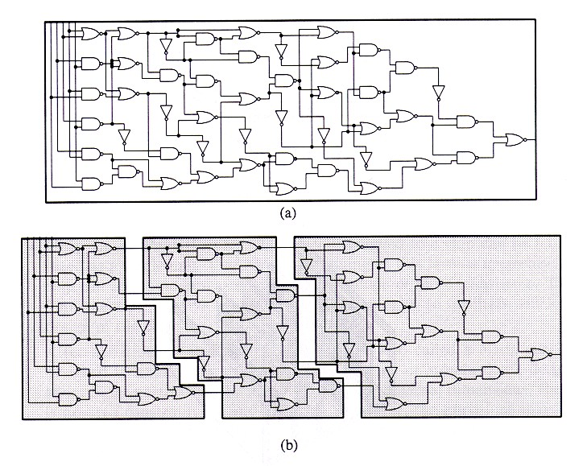
Recap: Circuit Partition
An essential step for reducing algorithm design complexity
Divide and conquer (D&C)
Input
A circuit graph
Output
A set of partitioned subgraphs
Objective
Minimize cross-connection

Slide 7
Recap: KL Algorithm
1. Pair-wise exchange of nodes to reduce cut size
2. Allow cut size to increase temporarily within a pass
3. Compute the gain of a swap
Repeat
Perform a feasible swap of max gain
Mark swapped nodes “locked”
Update swap gains
Until no feasible swap
4. Find max prefix partial sum in gain sequence g₁, g₂, …, g_{m}
5. Make corresponding swaps permanent
6. Start another pass if current pass reduces the cut size
u •
v •
v •
u •
locked

Slide 8
Recap: FM Algorithm
Moves are made based on object gain – extended from KL algorithms
Object Gain: The amount of change in cut crossings that will occur if an object is moved from its current partition into the other partition
A pass description
While there is unlocked object
Each object is assigned a gain
Objects are put into a sorted gain list
The object with the highest gain from the larger of the two sides is selected and moved
The moved object is "locked"
Gains of "touched" objects are recomputed
Gain lists are resorted
Repeat the pass until there is no improvement

Slide 9
State Space Search Problem
Combinatorial optimization problems (like partitioning) can be thought as a State Space Search Problem
A State is just a configuration of the combinatorial objects involved
The State Space is the set of all possible states (configurations)
A Neighborhood Structure is also defined (which states can one go in one step)
There is a cost corresponding to each state (e.g., cut)
Search for the min (or max) cost state (e.g., min-cut partition)

Slide 10
Greedy Algorithm
A very simple technique for State Space Search Problem
Start from any state to perform greedy, iterative improvement
Always move to a neighbor with the min cost (assume minimization problem)
Stop when all neighbors have a higher cost than the current state or no improvement can be made

Slide 11
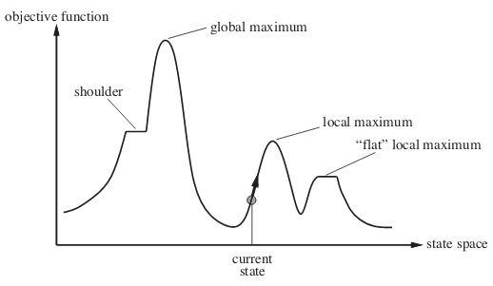
Problem with Greedy Algorithm
Easily get stuck at local minimum with non-optimal solutions!
Solution quality highly depends on the “initial solution”
Optimal only for convex (or concave for maximization) functions

Slide 12
Greedy Nature of KL and FM
KL and FM are greedy algorithms
Purely greedy if we consider a pass as a “move”
A
B
Pass 1
Pass 2
Cut Value
Move
B
A
Partitions
Notes:
(explain …)
Now that we know greedy algorithm can get you stuck with local minima or maxima. Is there any way we can avoid that, or in other words, jump out of that local minima or maxima.

Slide 13
Simulated Annealing (SA) Algorithm
Very general search technique to avoid being trapped in local minimum by making probabilistic moves
Kirkpatrick, Gelatt and Vecchi, “Optimization by Simulated Annealing”, Science, 220(4598):498-516, May 1983
Almost same as old, greedy one, with two big changes
Hill-climbing T, start T=Hot=BIG, slowly reduce T over many swaps
If a swap makes result become worse, randomly accept it with probability P(ΔL, T)
Notes:
The answer to that question is yes, and that brings us to a very famous algorithm, simulated annealing, or SA, algorithm. SA is very general search techniques that mimics the behavior of how nature optimize its energy system. The first SA paper was introduced by Kirk in the journal science, “optimization by simulated annealing”, and you can find more details and motivation about SA in this paper.
SA is almost same as the old greey algorithm, but with two big changes (explain …)

Slide 14

Basic Ideas of SA
Inspired by the Annealing Process
Attaining a min cost state in simulated annealing is analogous to attaining a good crystal structure in annealing
The process of carefully cooling molten metals in order to obtain a good crystal structure
First, metal is heated to a very high temperature
Then slowly cooled
By cooling at a proper rate, atoms will have an increased chance to regain proper crystal structure
Notes:
The basic idea of SA is in fact an inspiration by the annealing process. You know, attaining a min-cost state in simulated annealing is analogous to attaining a good crystal structure in annealing, and that is a process of carefully colling molten metals in order to obtain a good crystal structure. (explain …)

Slide 15
Basic Ideas of SA (cont’d)
Non-zero probability for “up-hill” moves
Avoid being trapped in local optima
Controlled by annealing schedule and solution improvement
Notes:
Unlike greedy algorithm which always looks for a solution that can improve your cost or objective function, the most important difference in SA is “non-zero probability for up-hill moves).

Slide 16
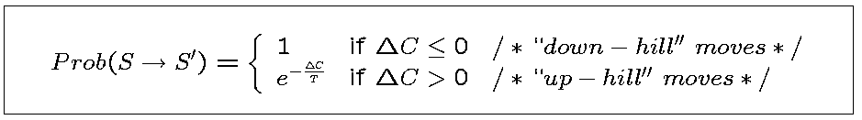
Basic Ideas of SA (cont’d)
Assuming minimization, such probability depends on
magnitude of the “up-hill” movement
total search time (i.e., implicitly told by the current temperature)
where
△C = cost(S’) – cost(S)
T: Current temperature
Annealing schedule: T = T₀, T₁, T₂,…, where T_{i} = r^{i}T₀, r <1.

Slide 17
Things to Consider in SA
When solving a combinatorial problem, we have to decide
The state space
The neighborhood structure
The cost function
The initial state
The initial temperature
The cooling schedule (how to change temperature)
The freezing point

Slide 18
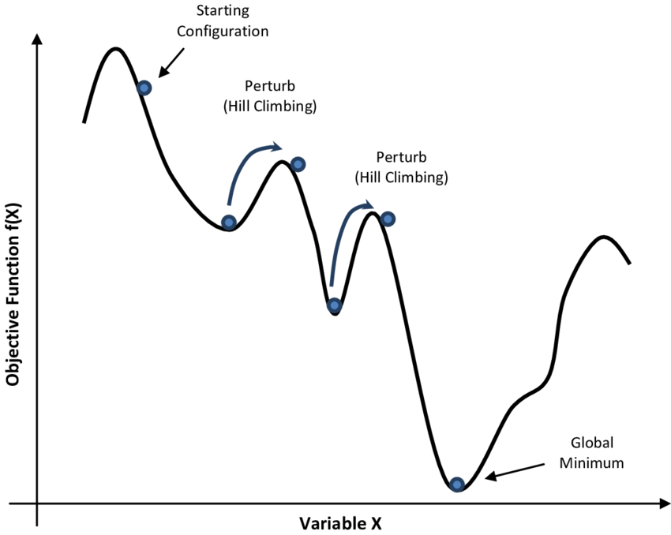
SA Algorithm Pseudocode
1 begin
2 Get an initial solution S;
3 Get an initial temperature T > 0;
4 while not yet “frozen” do
5 for i=1 to P do
6 Pick a random neighbor S’ of S;
7 △← cost(S’) – cost(S); /* down hill move */
8 if △ 0 then S←S’ /* uphill move */
9 if △ > 0 then S←S’ with probability;
10 T←rT ; /* reduce temperature */
11 return S
12 end
cost (S)
State S

Slide 19
Common Cooling Schedules
Initial temperature, cooling schedule, and freezing point are usually experimentally determined
Parameter tuning is very critical in getting a good SA result
In practice, we can do the following cooling schedules
t = αt, where α is typically around 0.95
t = e^{-βt}, where β is typically around 0.7
…

Slide 20
Basic SA Algorithm Structure
Solution space
Represent the state size (e.g., possible solutions) we define for the optimization problem
Neighborhood structure
Represent the state change after applying a local move
We don’t want radical or sharp change! (why?)
Cost function
Represent the objective of the optimization problem
Annealing schedule
Represent the temperature decreasing process
Notes:
Here, we summarize the basic algorithm structure of designing an SA algorithm. There are four components, solution space, neighborhood structure, cost function, and annealing schedule. (explain)

Slide 21
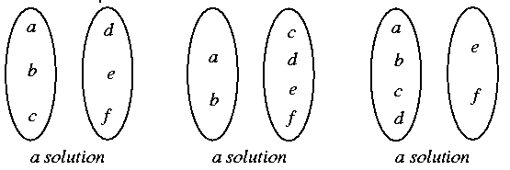
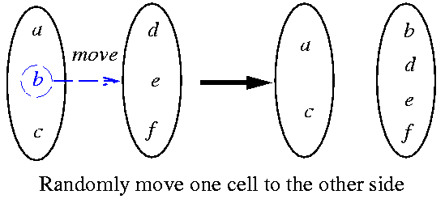
SA-based Partitioning Algorithm
Solution space: set of all partitioning solutions
Neighborhood structure: move one cell to another partition
Notes:
Let’s take a look at how SA can be applied to our partitioning problem. In this case, the solution space is essentially the set of all partitioning solutions. For example, assuming an example of six cells, a, b, c, d, e, f, we can have the following three different possible solutions. The first one has a, b, c on one partition and the d, e, f on another partition. The second one (explain…)
In terms of neighborhood structure, we move one cells at a time or at each iteration from its partition to another partition and inspect if we can get a better result. For instance, in this partition, I choose to move b from the left partition to the right partition, giving me the result of a c in one partition and b d e f in another partition. And if you compare this partition with its original partition, the change or the difference is not large, only one cell difference and that is the cell b we just moved. This is another key part to deciding whether an algorithm can be improved by SA. The algorithm strategy you apply or design to improve the solution quality has to be incremental instead of radical.
If that change is radical, there is no difference than starting with an initial solution that is totally different from the one you have, right?

Slide 22
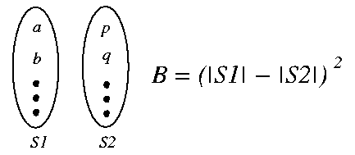
SA-based Partitioning Algorithm (cont’d)
Cost function: f = C + λB
C: the solution cost as used before
B: a measure of balance
λ: a constant
Annealing schedule
T_{n} = r^{n}T₀, r = 0.9
At each temperature, either 1. There are 10 accepted moves/cell on the average, or 2. # of attempts = 100 * total # of cells.
The system is “frozen” if very low acceptances at 3 consecutive temperatures
Notes:
The cost function for SA-based partition algorithm can be made of two parts, the capital C representing the cut, you know, the number of cross edges, and the capital B representing the balance criteria. And we can use a constant to balance or favor a particular part. For instance, if I have lambda very large here, than the algorithm will put more effort on balancing the partition results because if you have a unbalanced partition then lambda multiplying B will become large. Or similarly, if I have a small value of lambda, the algorithm will put the cut minimization in the top priority because the balance criteria is essentially very small in the objective function.
That is the cost part, any question?
In terms of annealing schedule, I can do the following: I will decrease the temperature by 10% at each temperature iteration. Within each temperature iteration, I am going to perform many different moves to search a better neighborhood structure. A simple strategy can be either doing 10 accepted moves on the average of when the number of the attempted moves is larger than, say, 100 x the total number of cells.
Finally, the system is frozen when the temperature becomes very low. (explain …)

Slide 23
Evaluation of SA-based Partitioning
An extensive empirical study of Simulated Annealing versus Iterative Improvement Approaches have been studied over the past decades
Conclusion: SA is a competitive approach, getting better solutions than KL/FM for random graphs
Remarks about SA:
Netlists are not random graphs, but sparse graphs with local structure
Yet, SA is often too slow—so KL/FM variants are still most popular
Multiple runs of KL/FM variants with random initial solutions may be preferable to SA

Slide 24
Common Questions about SA
Does annealing always find the perfect, best global optimum?
NO. It is just good at avoiding a lot of local minimums
Does annealing work on every type of optimization problem?
NO. But it does work on many optimization problems–it is not always the most efficient option
Is annealing always slow– doing all those many swaps over many temperatures?
NO. Lots of engineering tricks to speed it up
Do I have to set all the parameters by trial and error?
YES/NO. There are fancy adaptive techniques to determine these automatically but they could also be problem-dependent

Slide 25
The Use of Randomness
For any partitioning problem:
Suppose solutions are picked randomly
If |G|/|A| = r, Pr(at least 1 good in 5 trials) = 1-(1-r)⁵
If |G|/|A| = 0.001, Pr(at least 1 good in 5000 trials) = 1-(1-0.001)⁵⁰⁰⁰ = 0.9933
All solutions (state space)
G
This is actually NOT bad!
A
Good solutions
Notes:
Now we know the key idea behind SA is leveraging the power of randomness to improve the solution. You know, the hill-climbing process is accepting worse solution with certain probability and eat each temperature iteration we will try several thousands of local moves. Is there any theoretical guarantee behind this? Or, how do we evaluate the goodness of this randomness?
For any partitioning problem, we can quantify the solution set into two parts, the bad solution and the good solution sets. Let’s assume the entire solution set is A and the good solution set is G, and these solutions are picked randomly. If the ratio of G over A is r, you know, that essentially tells you the probability for you to get a good solution is r, right? (explain …)

Slide 26
Adding Randomness to KL/FM
In fact, # of good states are extremely few
Therefore, r is extremely small
Need extremely long time if just picking states randomly
Therefore, we can running KL/FM variants several times with random initial solutions
Good Initial States
Cut Value
Good States
Notes:
But of course, in practice, the number of good states or good solutions are extremely small. Otherwise, we can use SA to solve all the problems. That means, the r, the ratio of good solutions over all solutions, is extremely small, so the probability we just went through will be very small. It’s difficult to get good solution in this SA, random process. You will need extremely long time (explain…)
So, a better way might just running KL or FM algorithms or their variants several times with random initial solutions. Instead of introducing randomness in the algorithm itself, we introduce randomness in the initial solutions these algorithms depend on. (explain the figure)

Slide 27
Other Partitioning Approaches
KL/FM-SA Hybrid: Use KL/FM variant to find a good initial solution for SA, then improve that solution by SA at low temperature
Tabu Search
Genetic Algorithm
Spectral Methods (finding Eigenvectors)
Network Flows
Quadratic Programming
…
Notes:
Based on this idea of random initial solutions, there are many partitioning approaches. For instance, (explain …)

Slide 28
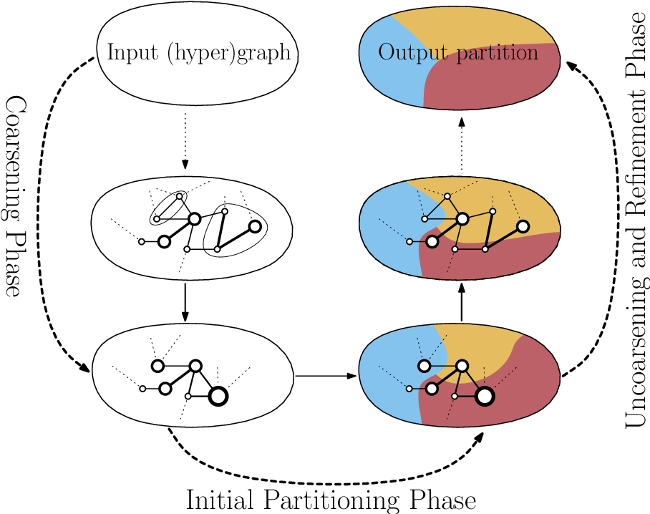
Multilevel Partitioning Techniques
Notes:
Another popular method of partitioning algorithm is multilevel partitioning techniques. The idea is divid—and-conquer. You can two stages, coarsening and uncoarsening stages, to iteratively partition and refine the solution. You start with an input graph or hypergraph and iteratively cluster nodes based on their connectivity to reduce the graph size. Until you have clustered the graph into a scale suitable for managing complexity, you perform FM or KL to minimize the cut. Then you enter the second stage to uncoarsen the graph or uncluster the graph to get the partition result. Again, during the unclustering process, you will apply FM or KL to iteratively improve the solution quality.

Slide 29
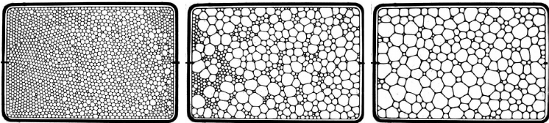
Motivation of Coarsening
Find a small, representable graph of the original one
Preserve the structure of the original graph
Preserve the similarity to the original graph
Reduce complexity by running on the coarsened graph

Slide 30
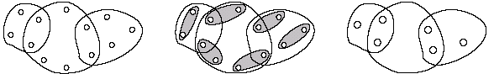
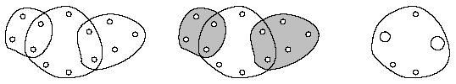
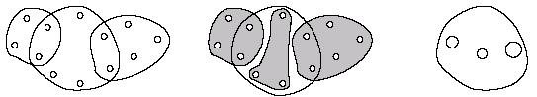
Coarsening Phase
Edge coarsening
Hyperedge coarsening (HEC)
Modified hyperedge coarsening (MHEC)
Notes:
As I said, the first stage is to coarsen the graph or cluster nodes in the graph to make the graph smaller. How do we do this? Well, people have come up with many different strategies, such as edge coarsening, (explain …)

Slide 31
Uncoarsening Phase
Based on FM with two simplifications
Limit number of passes to 2
Early-Exit FM (FM-EE), stop each pass if k vertex moves do not improve the cut
Hyperedge Refinement
Move a group of vertices between partitions so that an entire hyperedge is removed from the cut
Notes:
The result of phase 1 is a reduced graph or a clustered graph. Then, in the next phase, the goal is to uncoarsen the graph, you know, to uncluster the graph to form our partition. During this process, when I ungroup a cluster, I introduce a new set of vertices in that group, right? So, I will iteratively apply FM or KL to refine the solution. And there are many strategies you can use to make it run faster. For instance, (explain …)

Slide 32
hMETIS Algorithm: A Mixed Strategy
George Karypis and Vipin Kumar, "Multilevel k-way Hypergraph Partitioning," 1999 ACM/IEEE DAC (will be one our in-class research paper presentation)
https://course.ece.cmu.edu/~ee760/760docs/hMetisManual.pdf
hMETIS-EE₂₀
20 random initial partitions
with 10 runs using HEC for coarsening
with 10 runs using MHEC for coarsening
FM-EE for refinement
Notes:
In fact, this two-phase, or two-stage partitioning algorithm is introduced by the very famous software, hMETS. Still today, industry is using the algorithm to partition circuits and their graphs. It’s developed by a group in University of Minnesota and you can download their manual at this link.

Slide 33
Summary
We have discussed problems of greedy partitioning algorithms
We have discussed simulated annealing (SA) algorithm
We have discussed SA-based partitioning algorithm
We have discussed multi-level partitioning algorithms

